Slide 1
Automated Essay Scoring
Kevin Anthony S. Sison
Van Arloe M. Yu
Notes:
Good afternoon everyone, today I’ll be presenting our project Automated Essay Scoring.

Slide 2
Automated Essay Scoring (AES)
is grading student essays without human interference
input
essay written for a given prompt
output
a numeric score reflecting its quality, based on its content, grammar, and organization
Notes:
Automated Essay Scoring or (AES)
Is simply the grading of student essays without human interference
The input of the model will be the essays written for a given prompt or topic
The output of the model is a numeric score reflecting its quality, based on its content, grammar, and organization

Slide 3

The Hewlett Foundation: Automated Essay Scoring
Notes:
Our dataset was taken from a Kaggle competition
It was a competition from The Hewlett Foundation: Automated Essay Scoring last 2012.
The cash price back then was $100k.

Slide 4
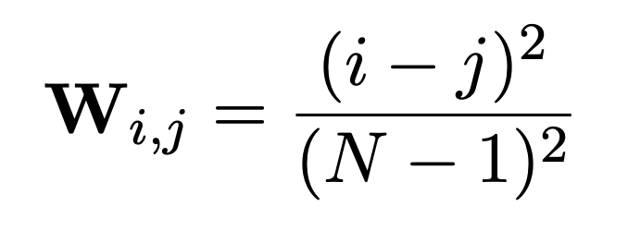
Quadratic Weighted Kappa (QWK)
measures the agreement between two ratings
0
random
{
1
complete
Notes:
The success metric was Quadratic Weighted Kappa (QWK)
Which measures the agreement between two ratings
The minimum score is 0 for a random agreement between different raters
The maximum score is 1 for a complete agreement between different raters.

Slide 5
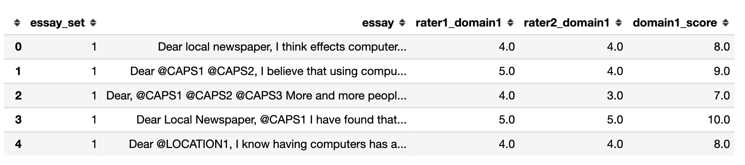
Data Description
QWK = 0.9693
8 essay sets
12,977 essay text
2 Human Raters
Total Score
Essay set
Notes:
Here’s is a preview of the dataset.
The dataset contains 8 sets of prompts/topics.
It contains 13k essays.
It was rated by two human raters
Then those two scores were added together to get the final total score.
From this we can get our human baseline of 0.9693 QWK.

Slide 6
Sample Essay
"Dear Newspaper, People should play with their family and friends instead of staying on the computer all the time. People would be more fit, have closer bonds with their family, and get better grades in school. People will alway get fit faster if they excersise instead of staying on the computer. When the computer is unpluged, anyone has a chance to go out side and play. When people go outside to play with their friends, they excersise which causes you to lose weight. @NUM1 scientist believe that it is better to go outside and socialize than to sit on a computer and watch monontenious videos. People would be more active if they stay of the computer and went outside because it will keep you happy with your body, and healthy so you don't die of a terrible diseases. Their would be closer bonds with families if people stayed of the computer. Family would be closer together instead of spreading apart by computers. Your family is always their to comfort you when ever you have a terrible day. Your family will help you get over any problem so that you can keep moving forward. If you did this by computer, all you see is a persons face who can't comfort you with a hug. Without computers, you get a closer family that loves and supports each other, but with computers, people just drive their families away. Closer families also help children in school get better grades. Families who stay of the computer and have dinner with their families typically have children that get better grades. @NUM2 scientist agree that kids who have dinner and play with their families get better grades in school. If kids get better grades in school from staying of the computer and spending quality time with their family, we could get great inventions that can help mankind in every single way. All of can happen from staying off of computers. Staying off computer is a great way to help yourself and other people to. It would get people fit, create closer bonds, and create more gradutes who go on and achieve the greatest of all inventions. Imagine what else could happen by staying of computers."
Notes:
Here is a sample essay from the dataset.
The task is to convert this unstructured data into a structured dataset that we can plug into our models.

Slide 7
Feature Engineering
Non-textual
Textual
Essay
sets
Count
Features (14)
Document
Embedding (15)
32 total features
Notes:
We did Feature Engineering based on past studies.
We used the essay sets feature as is and derived two main types of features. For this presentation, we are naming them as Non-Textual and Textual.
Non-textual pertains to the numeric features that we derive from the syntactic analysis of the text.
It’s broken down into 14 Count Features and 2 Collocation of n-grams features.
For textual features, it pertains to the representation of the text in a vectorized form. Here we used document embedding similar to what martin just discussed.
This gives us a total of 32 features.

Slide 8
Count Features
Word, Sentence,
Character Counts
# words
# sentences
# characters
Ave word length
Ave sentence length
Quality of Words
# stopwords
# vocabulary
# lemmas
Errors
# spelling errors
POS Tagging
# nouns
# adjectives
# verbs
# adverbs
# others
Collocations of n-grams
Notes:
For the count features.

Slide 9
Document Embedding
Collocations of n-grams
“I am at home. I am not in school. I am presenting my project. I am explaining.”
Collocation Likelihood ratio of n-grams
Ave bi-gram likelihood
Ave tri-gram likelihood
Notes:
So given an essay like this, we wanted to quantify if the n-grams used by the writer repetitive? Unique?
So we used a collocation likelihood ratio to compute for the average likelihood ratio of the bi-gram and tri-gram used in the essay.

Slide 10
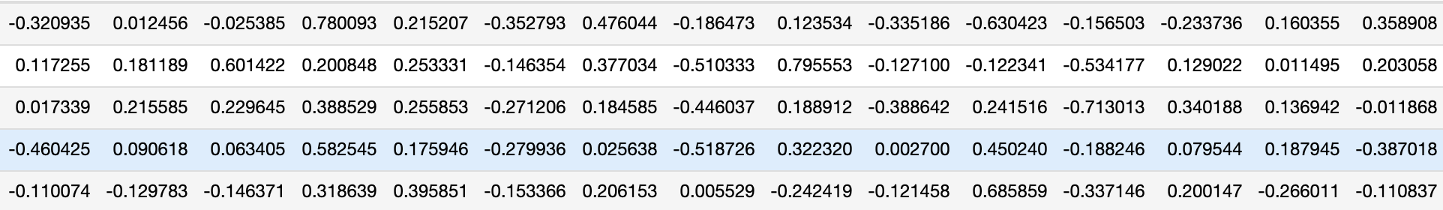
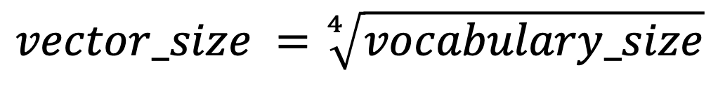
Document Embedding
General rule of thumb according to TensorFlow
$$vector_size =\sqrt[4]{vocabulary_size}$$
Document Embedding
Doc2Vec(documents, vector_size=15, window=2, min_count=1)
Notes:
Next, we proceeded with document embedding.
One interesting reference we found is that according to tensorflow, a general rule of thumb is that the vector size is the 4th root of the vocabulary size.
So we used 15 as our vector size and used Doc2Vec from gensim, with a window of 2. This is similar to what cedric presented earlier

Slide 11
Machine Learning Models
Gradient Boosting Regressor (GBR)
Multi-Layer Perceptron (MLP)
Long Short-Term Memory (LSTM)
Bidirectional Long Short-Term Memory (BiLSTM)
MLP+LSTM Ensemble
Notes:
For the machine learning stage, we tried 5 types of models.
Gradient Boosting Regressor (GBR)
Multi-Layer Perceptron (MLP)
Long Short-Term Memory (LSTM)
Bidirectional Long Short-Term Memory (BiLSTM)
MLP+LSTM Ensemble

Slide 12
Machine Learning Models
Model | Quadratic Cohen’s Kappa | Training Time
Kaggle (2012) | 0.82 | -
SSWE BiLSTM (2016) | 0.96 | -
BiLSTM | 0.9656 | 17 mins
LSTM | 0.9658 | 9 mins
Human Benchmark | 0.9693 | -
MLP | 0.9773 | 2 mins
GBR | 0.9848 | 6 mins
MLP+LSTM Ensemble | 0.9854 | 33 mins
BiLSTM
LSTM
MLP
GBR
MLP+LSTM
Ensemble
Notes:
Conference: Proceedings of the 54th Annual Meeting of the Association for Computational Linguistics (Volume 1: Long Papers)
So our results show that the two best performing models were GBR and our MLP+LSTM Ensemble.
We were able to beat the best performing Kaggle score, the highest score we saw in journal articles, and also beat our human benchmark earlier.

Slide 13
MLP+LSTM Ensemble a multiple data type input approach
GBR SHAP Feature Importance
Notes:
{'learning_rate': 0.1, 'loss': 'ls', 'max_depth': 6, 'max_features': 0.5, 'min_samples_split': 2}

Slide 14
MLP+LSTM Ensemble a multiple data type input approach
Impact of the Study
Non-textual
Textual

Slide 15




Future Studies
Impact of the Study
Standardize scoring mechanism in global examinations like the GRE, GMAT, TOEFL, and IELTS.
Reduce examiner bias in checking student essays.
Allow teachers to devote more time in improving their lessons and delivery.
Allow quick feedback to students so they can work on areas of weakness.

Slide 16


Future Studies
Essays in other languages (Chinese, Filipino, etc)
Data and model improvements to detect “gaming” of the AES
Garbage in, Garbage out. Improve the dataset to contain essay that attempt to game the system.

Slide 17
Elsevier Assessing Writing
https://www.journals.elsevier.com/assessing-writing

Slide 18
Thank you

Slide 19
Word, Sentence,
Character Counts
# words
# sentences
# characters
Ave word length
Ave sentence length
Quality of Words
# stopwords
# vocabulary
# lemmas
Errors
# spelling errors
POS Tagging
# nouns
# adjectives
# verbs
# adverbs
# others
Collocation Likelihood ratio of n-grams
Ave bi-gram likelihood
Ave tri-gram likelihood
Notes:
For the count features.

Slide 20
Non-textual
Textual
Fully connected deep network
LSTM
Fully connected deep network
Predicted score

Slide 21
MLP+LSTM Ensemble a multiple data type input approach
GBR Tree Visualization

